Slide 1
Stryke Force Talon SRX Motor Training Course
December 9, 2017
Jerry Culp

Slide 2
Agenda
How does a motor work (turning current into rotary motion)
Motor performance (speed/torque curves and what they mean)
Talon SRX overview
Talon control modes
Encoders
Configuring an entire axis (Talon SRX + sensor + motor)
Open loop
Closed loop - PID
Tuning a Closed loop
Velocity
Position
Motion Magic

Slide 3
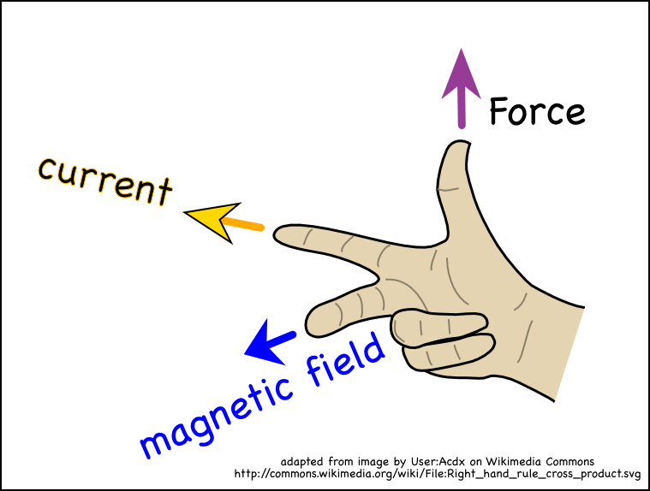
How does a motor work
The Right Hand Rule

Slide 4
How does a motor work

Slide 5
How does a motor work

Slide 6
How does a motor work

Slide 7
How does a motor work

Slide 8
How does a motor work

Slide 9
How does a motor work

Slide 10
How does a motor work
This is how we make torque

Slide 11
How does a generator work
What is “Back EMF”?

Slide 12
How does a motor work
Electrical Schematic of a Motor
Volts = Speed
Amps = Torque

Slide 13
Motor Performance
Stall Torque
Free Speed

Slide 14
Motor Performance

Slide 15
Motor Performance
Speed Torque Curve

Slide 16
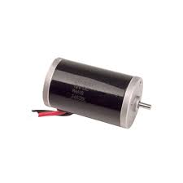
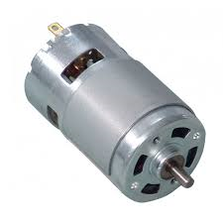
Motor Performance
CIM
Lots of copper
Low speed
Heavy
No fan
Bag
Less copper
Medium speed
Light
No fan
775
Less copper
High speed
Light
Fan

Slide 17
Motor Performance - CIM

Slide 18
Motor Performance - 775

Slide 19
Motor Performance
Motor | Price | Max Power | Free Speed | Stall Torque | Weight
CIM | $28 | 337 W | 5,310 rpm | 2.4 N-m | 2.82 lbs
Mini-CIM | $25 | 230 W | 6,200 rpm | 1.4 N-m | 2.16 lbs
BAG | $25 | 147 W | 13,100 rpm | .43 N-m | .71 lb
RS-775pro | $18 | 347 W | 18,700 rpm | .71 N-m | .74 lb
RS-550 | $7 | 253 W | 19,300 rpm | .48 N-m | .48 lb
AM-9015 | $14 | 179 W | 16,000 rpm | .43 N-m | .5 lb
Snow Blower Motor | $39 | 20 W | 100 rpm | 7.9 N-m | 1.1 lbs

Slide 20
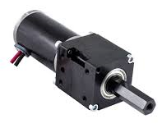
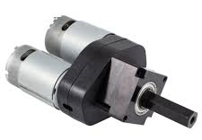
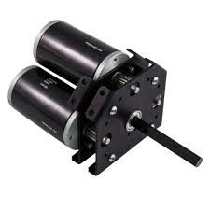
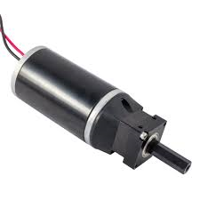
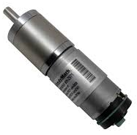
Motor Performance
Gearbox Options (change the speed / torque relationship)

Slide 21
Motor Performance
Heat!

Slide 22
Motor Performance - PWM
ON = 12 volts OFF = 0 volts
= 6 volts
= 9 volts
= 3 volts
Pulse Width Modulation

Slide 23
Motor Performance - PWM

Slide 24
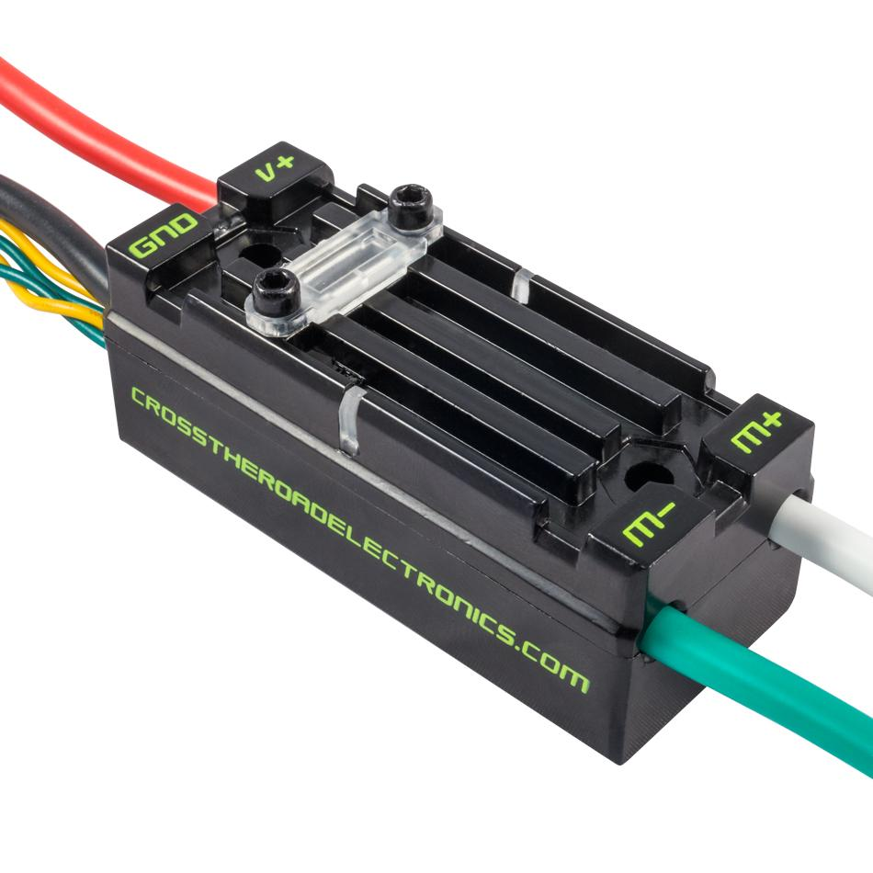
Talon SRX

Slide 25
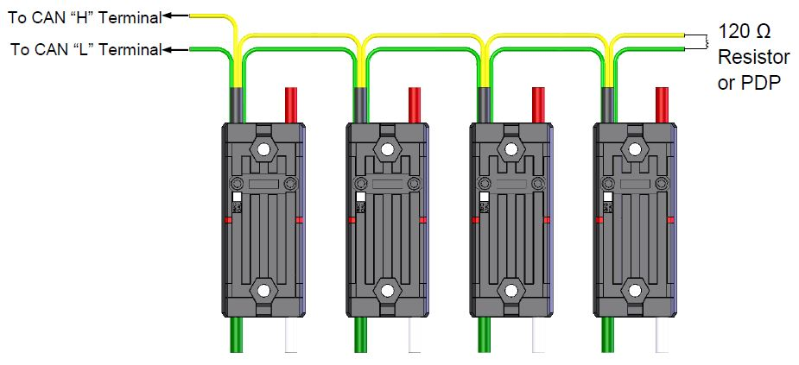
Talon SRX Wiring

Slide 26
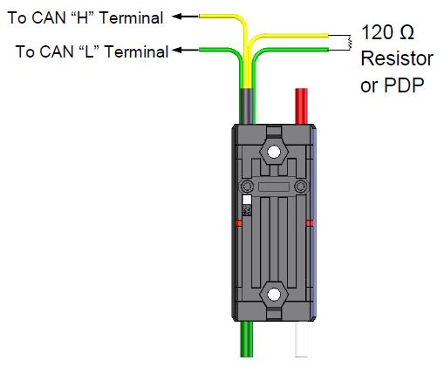
Talon SRX Communications
PWM
CAN Bus
Frames
Command – 10mS
General – 20mS
Feedback – 20mS
Quadrature – 100mS
Analog – 100mS
Frame rates are programable
Watch out for CAN bus overload

Slide 27
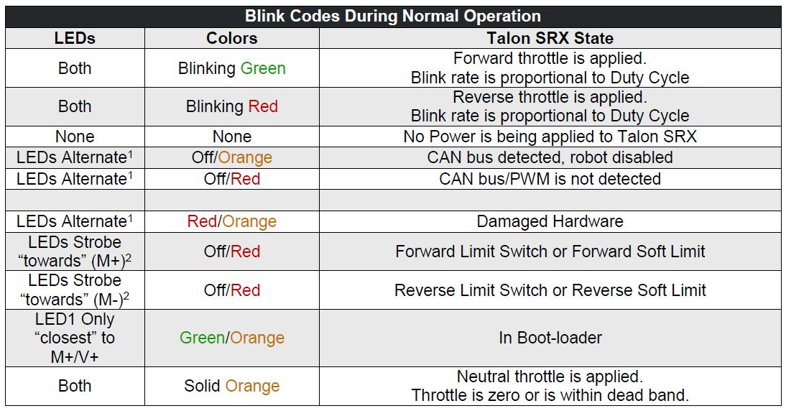
Talon SRX Blink Codes

Slide 28
Talon SRX Versions
Hardware
1.4 3.3 vs 5.0 volt Quadrature pins (Qb & Qi are limited to 3.3)
1.7
Firmware
X.XX (2018)
Remote sensor CAN connectivity
4 PID slots
2.34 (2017)
2.00 (2016)
older

Slide 29
Talon SRX Control Modes
Duty Cycle (-1 to 0 to +1)
Voltage (-12 to 0 to +12)
Velocity
Position
Current Control
Slave
Motion Control
Motion Magic

Slide 30
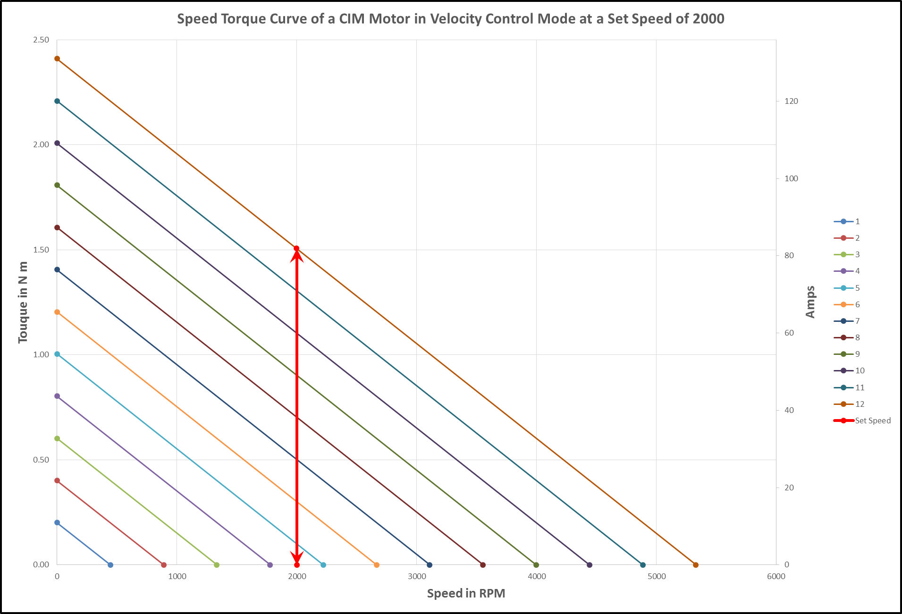
Control – Velocity Mode
The Talon will vary the drive voltage to move the motor torque (current) up and down on the red line to maintain a fixed speed. The Back EMF (V_{G}) of the motor will always match the speed. The Talon drive voltage beyond the BEMF is used to drive more current through the motor’s winding resistance (Ra) to generate more torque.

Slide 31
Talon SRX Parameters
P
I
D
FF
Izone
Max voltage out (+&-)
Nominal voltage (+&-)
Min Acceptable Error
Voltage Ramp
Voltage Ramp Closed loop
Current limit
Hard limits
NO / NC
Soft limits
Value
Reverse Encoder
Reverse Output
Encoder Scaling
Velocity Filtering

Slide 32
Talon SRX Sensors
Quadrature Encoder
US Digital
CIMcoder
AM Mag
CTR magcoder
Analog Encoder
Rotary potentiometer
String potentiometer
Limit Switch
Forward
Reverse
Soft limits
Other
DC Voltage
Frequency
Period
Duty Cycle

Slide 33
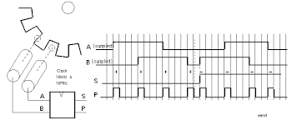
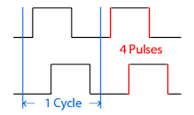
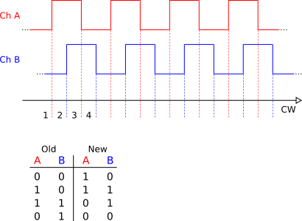
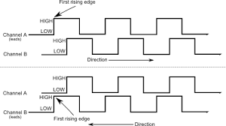
Encoders - Quadrature
How do they work?

Slide 34
Encoders - Quadrature

Slide 35
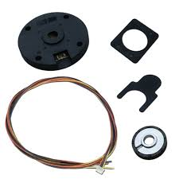
Encoders - Quadrature
CIMcoder
Magnetic
20 cycles per rev
80 counts per rev

Slide 36
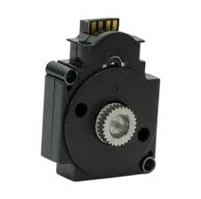
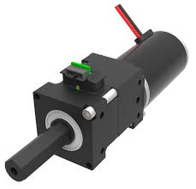
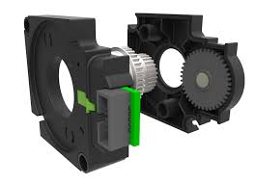
Encoders - Quadrature
CTR Magcoder
Magnetic
1024 cycles per rev
4096 counts per rev
Includes Absolute!

Slide 37
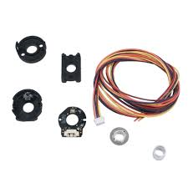
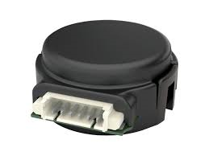
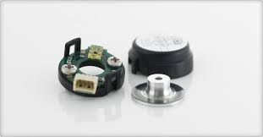
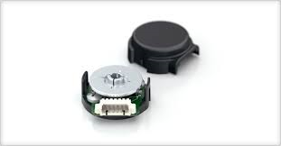
Encoders - Quadrature
US Digital E4T
Optical
360 cycles per rev
1440 counts per rev

Slide 38
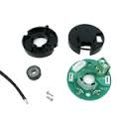
Encoders - Quadrature
Andy Mark
Magnetic
7 cycles per rev
28 counts per rev

Slide 39
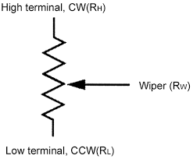
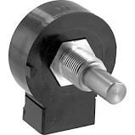
Encoders – Rotary Pots
Several Manufactures
Analog
Need an ATD
Absolute

Slide 40
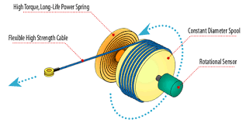
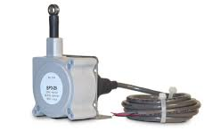
Encoders – String Pots
Several Manufactures
Analog
Need an ATD
Absolute

Slide 41
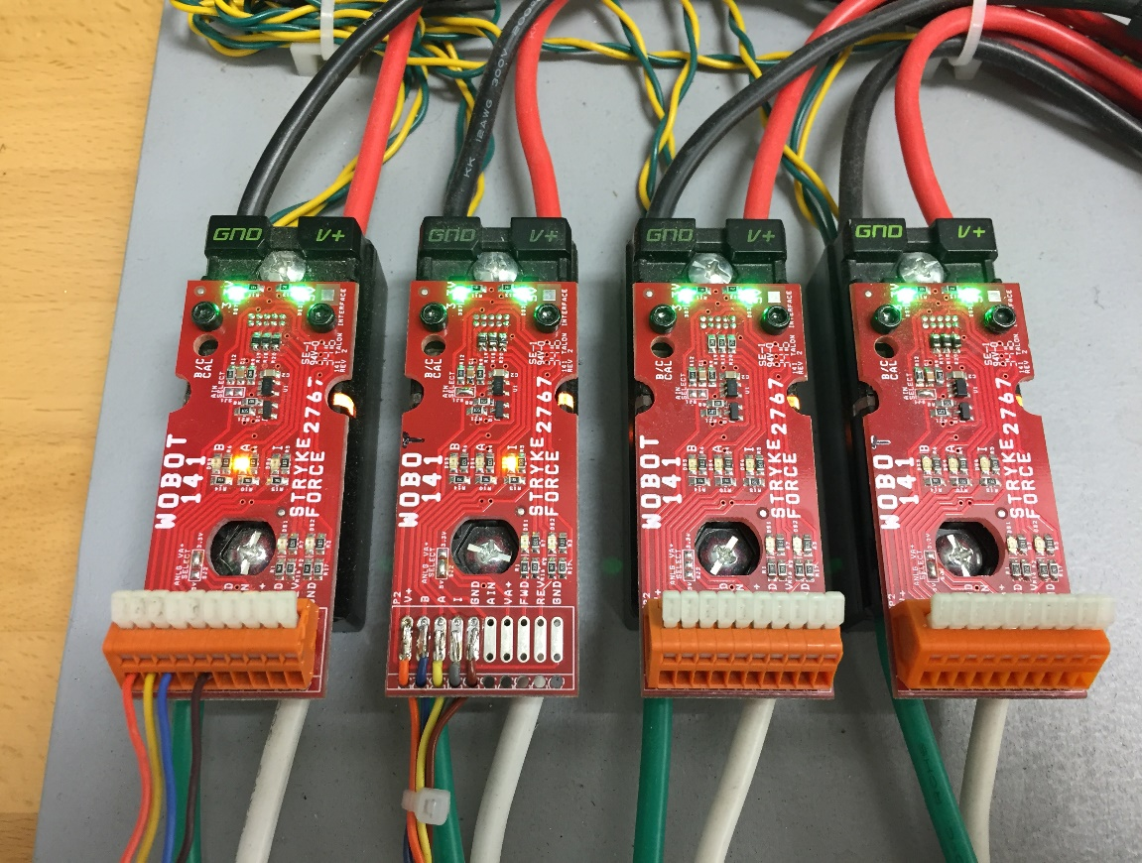
Encoders – Sentinel Interface
The Sentinel puts an end to any and all interface issues
Shameless plug … $18 and in stock at Andy Mark!

Slide 42
Control
Open Loop
Fixed voltage – Speed changes with load
Duty Cycle (-1 to 0 to +1)
Voltage (-12 to 0 to +12)
Closed Loop (add an encoder)
Variable voltage – Speed stays constant with load
Speed
Variable voltage – Position stays constant with load
Position & Motion Magic
Variable voltage – Torque stays constant with load (somewhat)
Constant Current

Slide 43
Control – PID
What on earth is PID?
Motor & Encoder
Motor power
Output shaft
Encoder wires

Slide 44
Control – P
Lets start with P

Slide 45
Control – Velocity Mode
The Talon will vary the drive voltage to move the motor torque (current) up and down on the red line to maintain a fixed speed. The Back EMF (V_{G}) of the motor will always match the speed. The Talon drive voltage beyond the BEMF is used to drive more current through the motor’s winding resistance (Ra) to generate more torque.

Slide 46
Control – P only
Walk the line … a real live control loop!

Slide 47
Control – Tuning
You can tune a piano, but you can’t tuna a fish

Slide 48
Control – PI
Add in I

Slide 49
Control – PID
Add in D

Slide 50
Control – PID with FF
Feed Forward
F_{term}= K_{f}(t)

Slide 51
Control – PID Effects

Slide 52
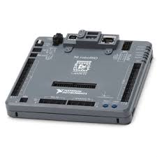
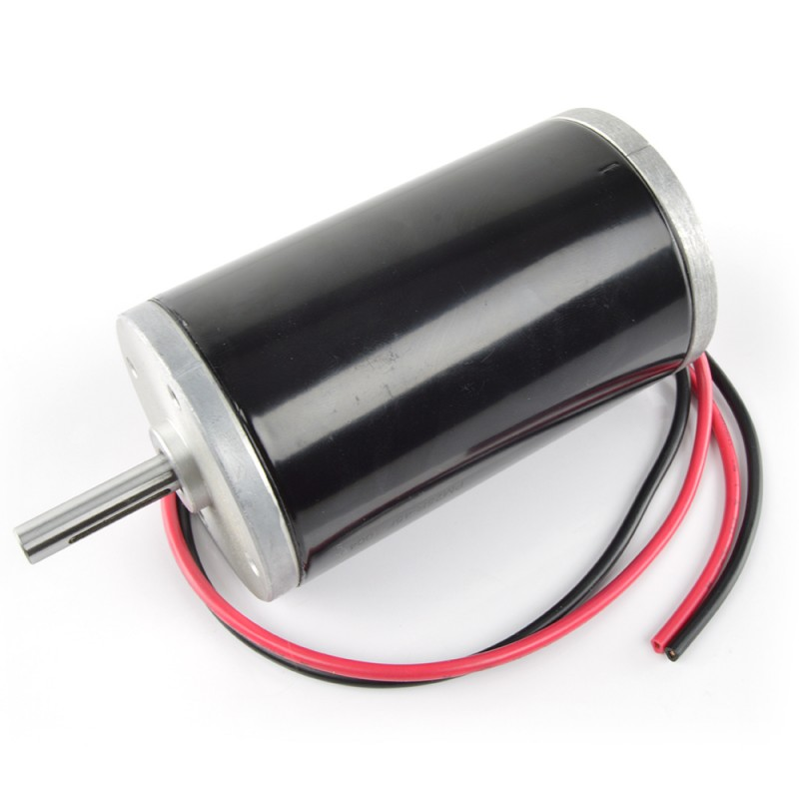
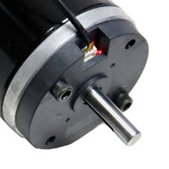
Control – The Real Thing
Lets do some tuning!

Slide 53
Tuning - Velocity
CIM & CIMcoder with a Pulley (no load)
I limit
F
P
I
Izone
D
Velocity Filter
Voltage Ramp

Slide 54
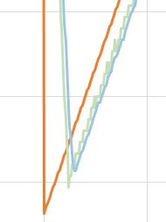
Tuning - Velocity
Velocity Filter – Period
Velocity Filter - Samples
Talon counts
Talon counts
Shaft
Talon input
After Period
After Samples
Period – 100mS
Samples - 64
Period – 25mS
Samples - 8

Slide 55
Tuning - Velocity
CIM & CIMcoder with a Pulley (no load)
with Drag
with Inertia
with Drag and Inertia

Slide 56
Tuning - Position
9015 with Vex 100:1
I limit
P
D
Voltage Ramp
Voltage Max Limit

Slide 57
Tuning – Motion Magic
A Position loop running on top of a Velocity loop
I limit
F
Cruise
Acceleration
P
D
Nominal Error (min acceptable error)

Slide 58
Quick Guide to Simple Tuning
Disclaimer!
This is a quick start on how to get something up and running with a “seat of the pants” approach.
This is not a comprehensive tuning process.

Slide 59
Quick Guide to Simple Tuning
For a standard velocity loop with some amount of static load / drag
Ensure FF, P, I, D, Izone are all set to zero. Ensure Max FWD and Max REV volt are set to 12 and -12.
Ensure your encoder is in phase with your motor. Run the motor in voltage mode and note that a positive voltage creates a positive velocity. If not, reverse the encoder.
Select Velocity mode
Increase FF until the actual velocity (process variable) is close to, but not higher than the requested velocity (set point) throughout the desired dynamic range.
Increase P until the loop goes unstable indicated by continual oscillations or a long time to stop oscillating. Then cut that P value in half. Check it throughout the entire dynamic range.
Run through the range of desired set points and note the largest error at any single speed.
Set Izone to 1.5x of the largest error observed in step 6
Increase I until the loop goes unstable. Reduce I until the settling time is optimized. You will end up trading off some overshoot vs a longer settling time. (I will likely be one tenth of P)
If required, increase D to reduce the overshoot incurred in step 8. (D will likely be 10 to 100x of P)
Go back and adjust P, then I, then D to observe the effects. They all interact so after the first pass, there may be some tweaks that will improve the performance.
You may find that limiting the Max FWD and Max REV will help stabilize the loop if you don’t need the full speed.

Slide 60
Quick Guide to Simple Tuning
For a standard position loop with some amount of static load
Ensure FF, P, I, D, Izone are all set to zero. Ensure Max FWD and Max REV volt are set to 12 and -12.
Ensure your encoder is in phase with your motor. Run the motor in voltage mode and note that a positive voltage creates a positive position change. If not, reverse the encoder.
Select positon mode
IF there is a static load on the axis that ALWAYS loads the system in the SAME direction, Increase FF until position (process variable) is close to, but not higher than the requested position (set point) throughout the desired dynamic range. If there is no static load leave FF at zero.
Increase P until the loop goes unstable. It will continue to oscillate or takes a long time to settle. Then cut that P value in half. Check it throughout the entire dynamic range.
Increase D to manage the position overshoot that results from increasing P. With some D, you will likely be able to increase P beyond what was stable with P alone.
A PD approach may be sufficient to drive the position close enough to the desired setpoint.
You may find that limiting the Max FWD and Max REV will help stabilize the loop if you don’t need the full speed.
If you need more precision … continue

Slide 61
Quick Guide to Simple Tuning
For a standard position loop with some amount of static load (continued)
Run through the range of desired set points and note the largest error at any position.
Set Izone to 1.5x of the largest error observed in step 3
Increase I until the loop goes unstable. Reduce I until the settling time is optimized. You will end up trading off some overshoot vs a longer settling time.
Go back and adjust P, then I, then D to observe the effects. They all interact so after the first pass, there may be some tweaks that will improve the performance.
If you have a high resolution encoder (lots of ticks per distance) you may find the increasing the Minimum Error to the max you can tolerate will help stabilize the loop.
You may also find that increasing the nominal FWD and REV voltages to the minimum amount that will actually make the axis move (in voltage mode) will also help stabilize the loop, especially if you are using some I.
If your axis goes over center where gravity or some other force loads the system in both directions, do no use any FF. Just start with P and go from there.

Slide 62
REO Speedwagon 1978
You can Tune a piano, but you can’t Tuna a fish

Slide 63
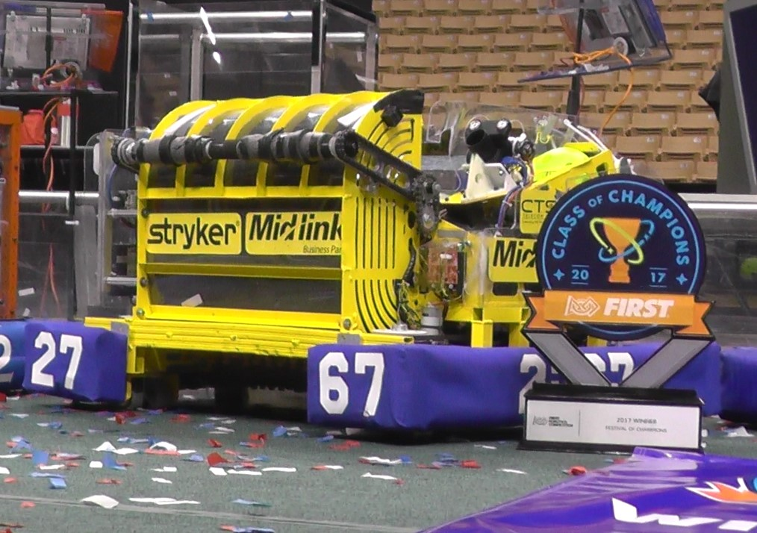
Questions?

